Slide 1


INDUSTRY 4.0
Why Wireless Matters in Industry 4.0
Industry 4.0 demands flexible, mobile, and scalable communication. Wired systems like PROFINET offer stable timing but are expensive to install and hard to reconfigure. Wireless enables AGVs, mobile sensors, and remote monitoring — but the real question is: which wireless standard fits which industrial task?

Slide 2


The Industrial Wireless Environment
Why Factories Are Hard on Wireless
Metal structures, motors, and moving machines create EMI, multipath fading, and unstable signal quality. Shared 2.4 GHz spectrum adds congestion; cybersecurity is critical.
Three Standards Under Evaluation
Wi-Fi / IEEE 802.11
Zigbee / IEEE 802.15.4
5G New Radio
High-bandwidth mobile communication
Low-power sensor networks
Real-time control & private networks
Evaluated on latency, throughput, reliability, energy use, and deployment complexity.

Slide 3
Literature Review
Industrial Wireless Communication for Industry 4.0

Slide 4
2.1 Early Wireless Sensor Networks (WSN)
Foundation
WSN established the foundation of industrial wireless communication, based on IEEE 802.15.4 standards.
Main Goal
Collect and transmit data wirelessly with low power consumption, allowing devices to run on batteries for years.
Key Challenges
Unstable delays, electromagnetic interference from machines, and signal loss in metallic factory environments.
Significance
Despite the challenges, WSN shaped the design principles still used in modern industrial wireless systems today.

Slide 5
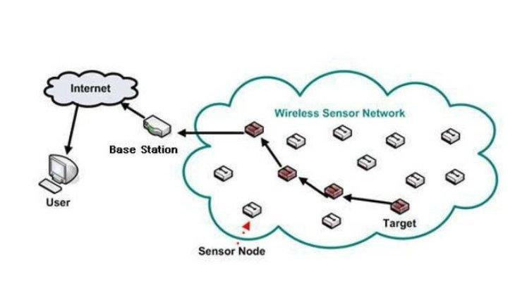
2.1 WSN Architecture Overview
Typical WSN architecture: sensor nodes relay data through the network to a base station and the internet.

Slide 6
2.2 Industrial Wi-Fi Evolution
802.11b/g
High variable latency - not suitable for closed-loop industrial control.
802.11e
QoS introduced traffic prioritisation, improving reliability.
802.11n
MIMO antennas enabled spatial multiplexing and increased data rates.
Wi-Fi 6
OFDMA and TWT reduced latency to ~5 ms - suitable for high-bandwidth industrial applications.

Slide 7
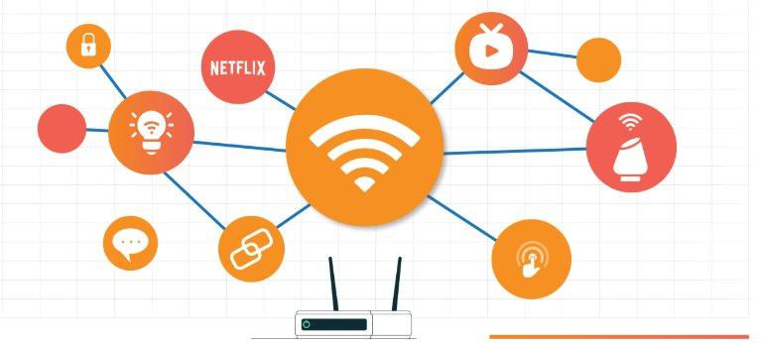
2.2 Industrial Wireless Connectivity
Wireless connectivity links across an industrial network routers, sensors, and IoT-enabled devices.

Slide 8
2.3 5G and the URLLC Paradigm
< 1 ms
99.9999%
70%+
Latency for motion control
Reliability (URLLC)
New private wireless spend on standalone 5G (2025)
• 3GPP Release 15 (2018): air interface standardised.
• Release 16 (2020): mini-slot scheduling added for URLLC.
• Release 16 also defines 5G as a TSN bridge for end-to-end deterministic delivery.
• Many industries are now adopting private 5G networks for real-time control tasks.

Slide 9
2.4 TSN Integration - Towards Wireless Determinism
What TSN Provides
• Credit-Based Shaping (
• Wireless becomes as reliable as wired PROFINET / EtherCAT.
• Time-Aware Shaping
• Wired and wireless robot axes driven by the same scheduler.
• Cyclic Queuing
• time synchronisation

Slide 10
Emerging Trends
Wi-Fi 7 · Private 5G · Wireless TSN

Slide 11
5.1 Wi-Fi 7 — Multi-Link Operation (MLO)
2.4 GHz
5 GHz
6 GHz
All three frequency bands used simultaneously
• MLO provides packet-level diversity — a dropped packet on one band is recovered on another without retransmission delay.
• IEEE 802.11be (Wi-Fi 7) is finalised. Draft 1.0 of Wi-Fi 8 (802.11bn) completed August 2025.

Slide 12
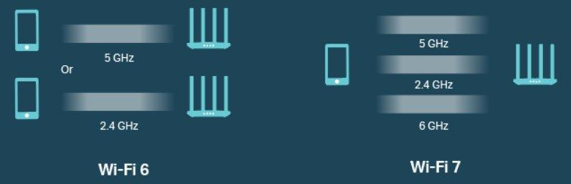
5.1 Wi-Fi 6 vs Wi-Fi 7 – Frequency Bands
Wi-Fi 6 uses 2.4/5 GHz bands, while Wi-Fi 7 adds the 6 GHz band for simultaneous multi-link operation.

Slide 13
5.2 Private 5G Campus Networks
of new private wireless
spend in 2025
• Companies build and manage their own 5G network instead of using public infrastructure.
• Full control over security, service levels, and spectrum allocation.
• Optimised for deterministic, high-density industrial environments such as factories.
• Complements industrial Ethernet and Wi-Fi in new factory deployments.

Slide 14
5.3 Wireless Time-Sensitive Networking
• TSN ensures data arrives at the exact required time - critical for real-time control.
• Closes the "last mile" gap: wireless now matches wired PROFINET and EtherCAT guarantees.
• A single TSN scheduler can drive both wired and wireless robot axes at the same time.

Slide 15
Wireless Standards: Architecture and Protocol Stack
Wi-Fi (802.11) · Zigbee (802.15.4) · 5G New Radio

Slide 16
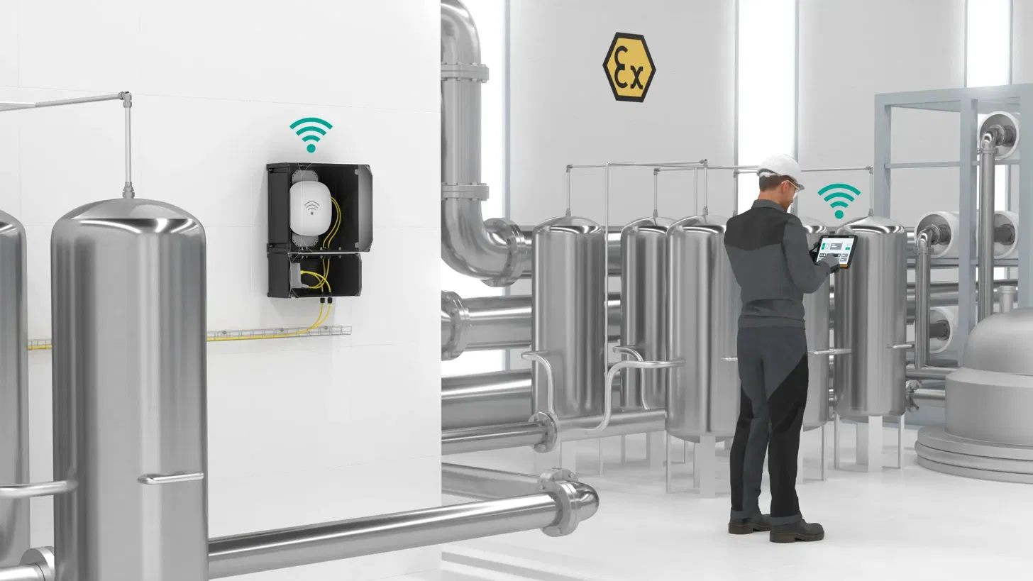
3.1 IEEE 802.11 (Wi-Fi)
Operates on 2.4, 5 and 6 GHz bands
CSMA/CA for channel access
Wi-Fi 6 adds OFDMA and TWT
802.11r enables fast roaming for AGVs
Throughput up to 9.6 Gbps
[ IMAGE ]
Wi-Fi factory deployment
PROS
High speed, huge ecosystem, native TCP/IP
CONS
Unreliable under load, shared spectrum

Slide 17
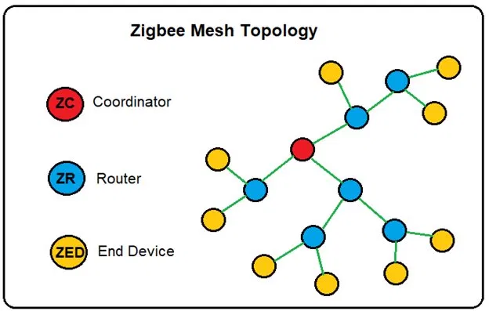
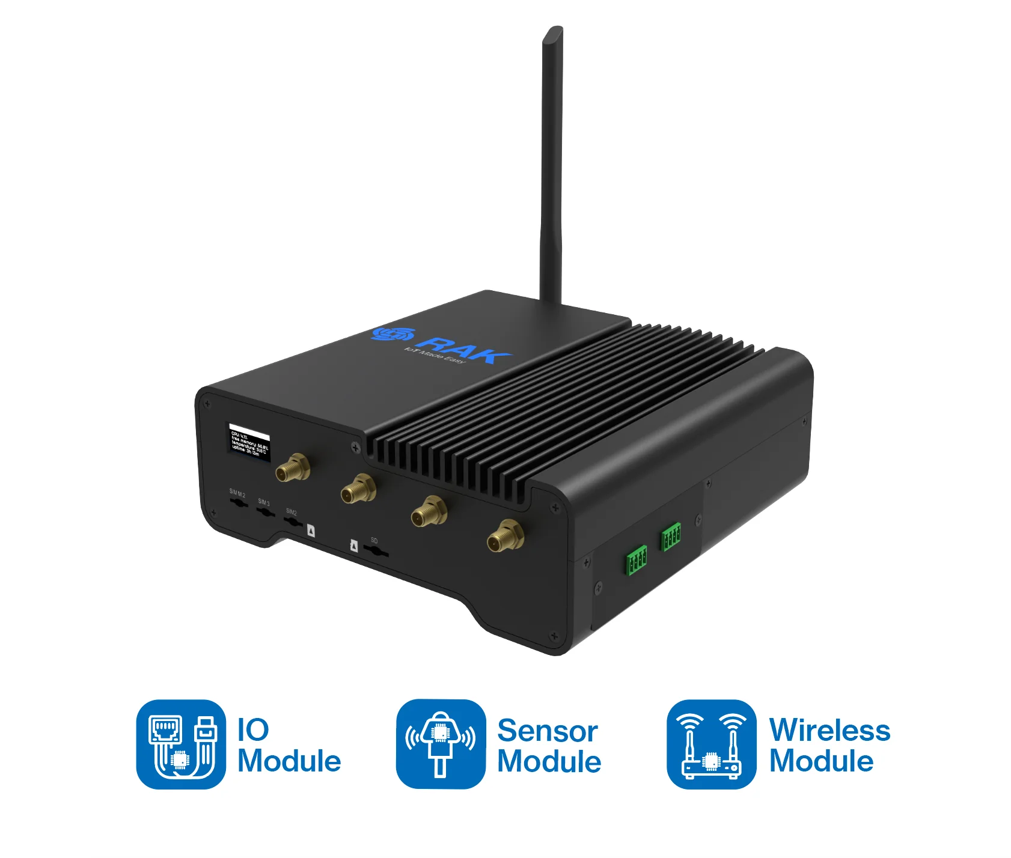
3.2 IEEE 802.15.4 / Zigbee
Low-power wireless WPAN standard
Runs at 2.4 GHz, up to 250 kbps
Three roles: Coordinator, Router, End Device
Supports star, tree and mesh topologies
Battery life of 2 to 5 years
[ IMAGE ]
Zigbee mesh topology
PROS
Long battery life, low cost, self-healing mesh
CONS
Low data rate, short range of 10 to 100 m

Slide 18
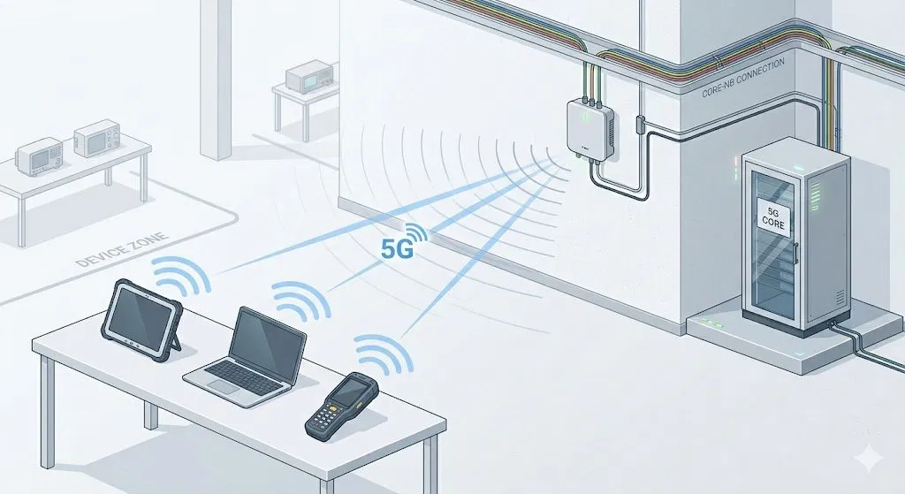
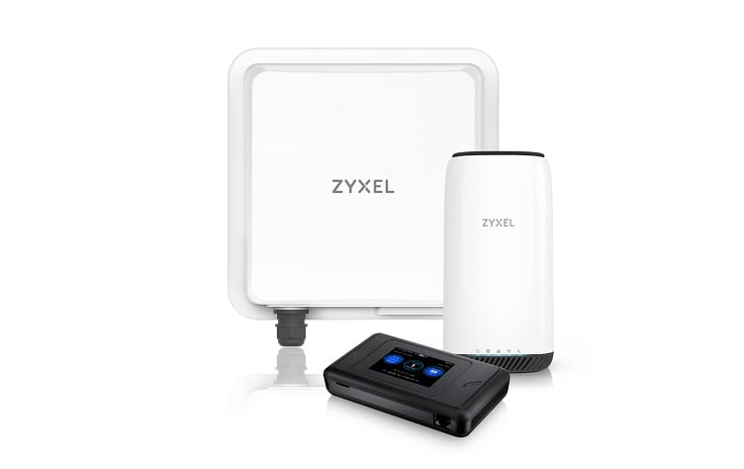
3.3 5G New Radio (NR)
Standardised by 3GPP, uses licensed bands
Three classes: eMBB, mMTC, URLLC
URLLC reaches under 1 ms at 99.999%
Private campus networks kept on site
Acts as a TSN bridge from Release 16
[ IMAGE ]
Private 5G campus network
PROS
Licensed spectrum, deterministic, private networks
CONS
Costly, complex, power-hungry

Slide 19
3.4 Standards at a Glance
 | Wi-Fi | Zigbee | 5G NR
Data rate | 9.6 Gbps | 250 kbps | Multi-Gbps
Latency | ~5 ms | 15 to 30 ms | < 1 ms
Range | ~100 m | 10 to 100 m | Wide / campus
Power use | High | Very low | High
Best for | High bandwidth | Sensors | Real-time control
Takeaway: no single standard fits every need, so factories mix all three by use case.

Slide 20

No Single Standard Fits Everything
The core finding: each standard excels in a different domain. Smart factories require a hybrid wireless architecture.
Standard
Best Suited For
Main Limitation
Wi-Fi 6/7
High-bandwidth mobile tasks: AGVs, machine vision, video monitoring
Shared spectrum, variable reliability
Zigbee
Low-power sensors: environmental monitoring, asset tracking
Low data rate
5G NR
Real-time control via URLLC in private campus networks
Higher cost & complexity
Key Takeaway: The optimal solution combines all three — matching each standard to its ideal use case.

Slide 21
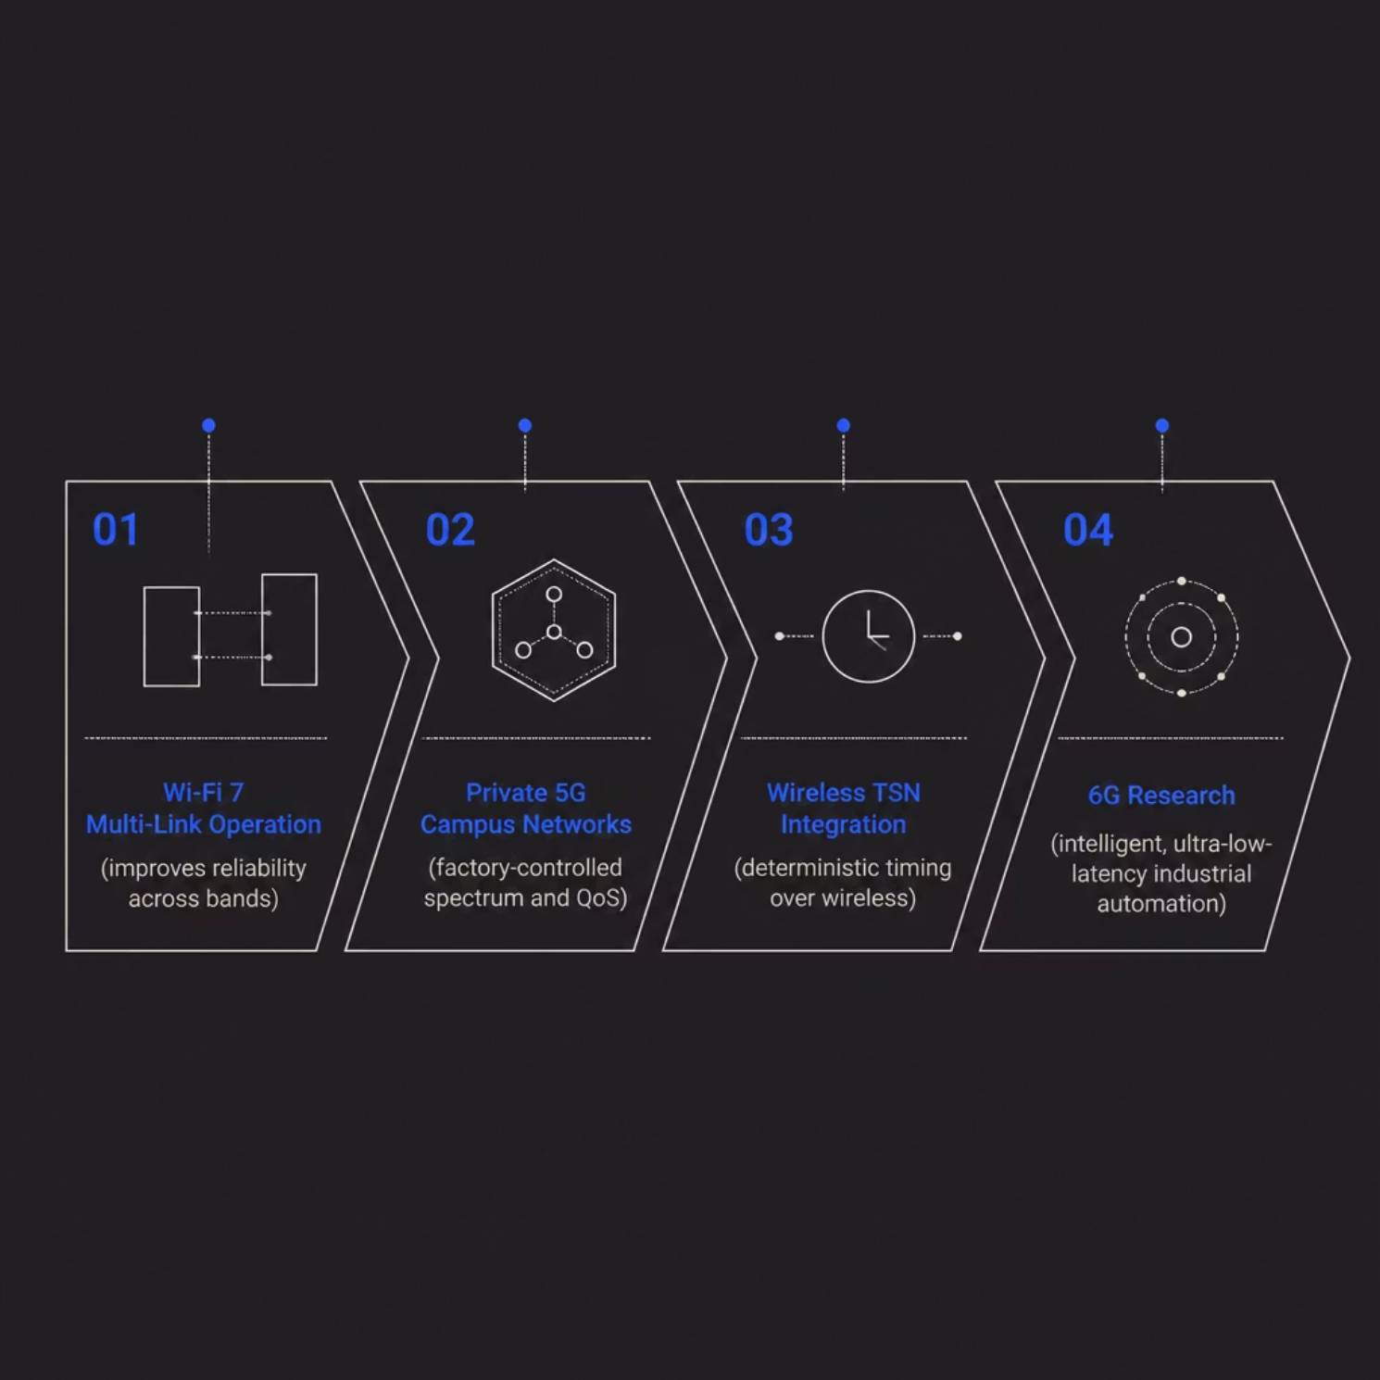
Future Direction: Toward Reliable Wireless Factories
Challenges Still to Solve
EMI and metal reflections
2.4 GHz band congestion
Cybersecurity risks
Deterministic timing gaps
Wi-Fi 7, private 5G, and Wireless TSN are closing the gap with wired systems. Wireless won't replace every cable — but it will become central to flexible, mobile Industry 4.0 factories.

Slide 22
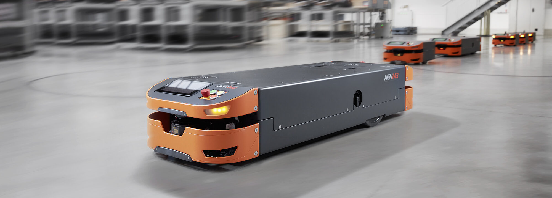


Evaluation example
Automated Production Cell Scenario
• Industry 4.0 production cell has different communication needs.
• 2 collaborative robots(cobots) require 1 ms latency and very high reliability.
• Sensors send small data packets every 30 seconds.
• AGVs need 10 Mbps video links with maximum 10 ms latency.
• Machine vision station transfers images to an edge server in 0.5 s

Slide 23
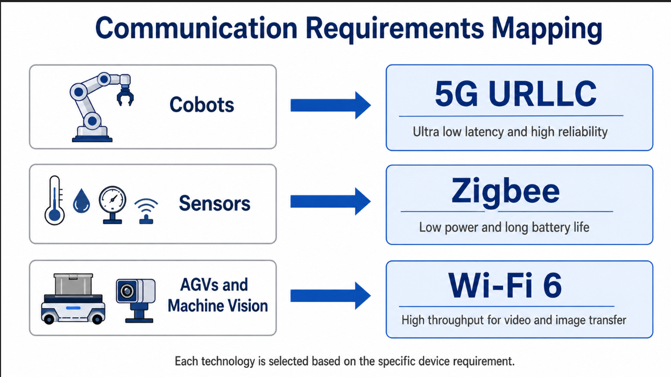

Slide 24
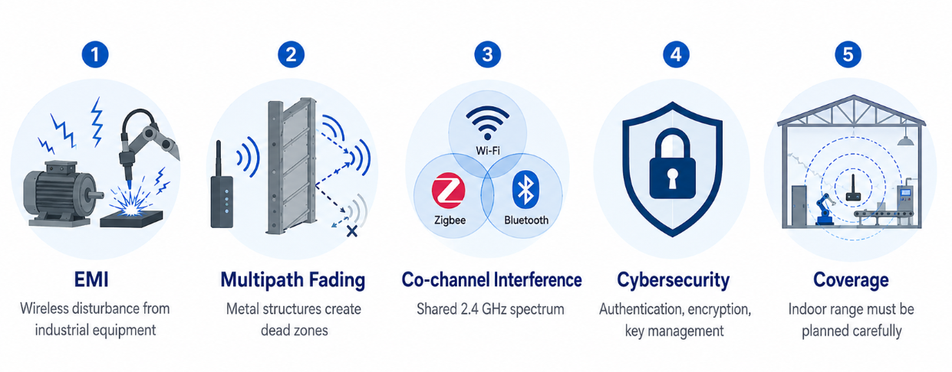
Deployment Challenges in Industrial Environments
• EMI from frequency converters, arc welders, and servo drives can disturb wireless communication
• Metallic factory environments cause multipath fading and signal dead zones
• Wi-Fi 6 and 5G handle multipath better than Zigbee because they use OFDM-based transmission
• Wi-Fi, Zigbee, and Bluetooth can interfere because they share the 2.4 GHz band
• Cybersecurity depends on correct configuration, authentication, encryption, and key management
• Indoor coverage is limited and must be carefully planned for Wi-Fi, Zigbee, and 5G mmWave

Slide 25
Pros and Cons Summary
5G URLLC provides the best performance for critical real-time control because it offers ultra-low latency, high reliability, licensed spectrum, and TSN support. However, it has high deployment costs, requires complex infrastructure, and consumes more energy.
Wi-Fi 6 is suitable for AGVs and machine vision because it provides high throughput and has a mature ecosystem, but it is non-deterministic and operates in shared spectrum.
Zigbee is the best option for low-power sensor networks because it is inexpensive, energy-efficient, and supports mesh networking, but it has limited throughput, higher latency, and security depends strongly on proper key management.
Technology | Latency | Throughput | Energy Use | Best Use
5G URLLC | ~1 ms | Very high | High | Cobots
Wi-Fi 6 | 2 to 5 ms | Multi-Gbps | Medium | AGVs and machine vision
Zigbee | 15 to 30 ms | 250 kbps | Very low | Sensors

